Slide 1

Unit-I
“ADVANCED ENTREPRENEURSHIP”
Dr. Rahul Pachori
Associate Professor
Faculty of Mechanical Engineering
SNIST
Notes:
Dr.R.Umamaheshwar Rao

Slide 2
ADVANCED ENTREPRENEURSHIP
Unit – I: Fundamentals of Entrepreneurship & Refining Business Model and Product:
Fundamentals and key concepts of entrepreneurship, refining the business model, products and services, pivoting, types of business models, business model evolution, generating new business models, analyzing the business model, adding new customer segment, product manager, significance and role of product manager.

Slide 3
Definition of Entrepreneurship
Entrepreneurship is defined as the professional application of knowledge, skills and competencies of generating a new business idea, by an individual or a set of people by launching an enterprise or business organization to pursue growth while generating wealth, employment and social good

Slide 4
Peter Drucker defined Entrepreneurship as ‘a systematic innovation, which consists in the purposeful and organized search for changes, and it is the systematic analysis of the opportunities such changes might offer for economic and social innovation.
Entrepreneur is a person who starts an enterprise. The process of creation is called entrepreneurship.
The entrepreneur is the actor and entrepreneurship is the act. The outcome of the actor and the act is called the enterprise.
An enterprise is the business organization that is formed and which provides goods and services, creates jobs, contributes to national income, exports and over all economic development.

Slide 5
Functions of Entrepreneurs
The main functions of entrepreneurs are
Planning:
Planning starts from New product development, procuring resources and to convert ideas into product/service, finding channel of distribution, right customer segment and commercialization.
2.Risk and Uncertainty bearing:
In today’s market dynamics modification in the existing products/services is must to retain customers and build, develop the business.
3.Organization building
Entrepreneurs has to assign the roles and responsibilities to the people to see that business goal is attained.
4.Managing
Entrepreneurs need to manage, collaborate, coordinate with all the entities for successful venture.

Slide 6
5. .Decision making
They need to decide whether to go for a new market or new product or both (Diversification).
6.Innovation
Always innovation is a continuous activity should be encouraged to remain competitive in the market place.
7.Leading:
Entrepreneur should lead the whole team starting from the idea generation till the final sales or delivery of innovative service to the end customers
8.Managing growth
They need to see that market share improves over a period of time and the innovative product is really creating a differential advantage in the market place.

Slide 7

Qualities and Skills of Entrepreneurship
Qualities of Entrepreneurship
Ability to Innovate
Business oriented tendency
Organizing function
Managerial and leadership function
Knowledge based function
Based on principles, not on intuition essential in every activity.

Slide 8
Skills of Entrepreneurship
Communication skills (possessing the ability to read, write and speaking in an understandable, accurate and professional manner)
Human relations skills (the ability to build and maintain positive relationships, working well with others)
Math skills (knowledge of basic arithmetic and business math skills such as calculating profit)
Problem-solving and Decision-making skills (the ability to assess situation and make good decisions)
Technical skills (knowledge of computers and how to use them productively)
Business skills (knowledge and understanding of the economy and business functions such as marketing and management)

Slide 9
Things to be done by Entrepreneur
Build a Business model
Building the right Business model is the key to success of start-ups. For every customer segment there should be one business model.
2. Build a sustainable Venture: The same business model should be carried in the future with slight modifications or minute changes in Lean canvas template
3.Build a Right Pitch: Identifying the right problem is the key to success of any business.

Slide 10
Various Steps involved are
1.REVISIT:
We need revisit our idea in the present scenario before converting our idea to products/services.
2. VALIDATE
We need to validate our goal with sustainable business venture.
3.REFINE
Refine the product with modifications or going for a new product/service
4.PIVOT
Appropriate Market for present product/services.
5. PLAN
Plan suitably for HR, Hiring, funding and technology.
6. INCREASE REVENUE
Increase revenues for product we are offering and get necessary funding
7.PITCH
Create and present the Business pitch. Also mange legal compliances and Registrations.

Slide 11
How do most successful Entrepreneurs do?
Identifying right Opportunities
Problem identification and assessing the right opportunity is the first step of successful venture.
2. Finding out the Problems/Products
Innovating product and services which finds the solution to the existing problems.
3. Recognizing Customer segment
Finding out the early adopters and targeting the right customer segment is the third step.
4.Anticipate future problems.
The product or service should able to solve or flexible enough to undergo modifications in solving future problems.

Slide 12
Business model
TYPES OF BUSINESS MODEL

Slide 13
Meaning of business model
A business model is an outline of how a company plans to make money with its product and customer base in a specific market.
Business Model is a Lean canvas , entrepreneur-focused and designed for emerging businesses: it takes only minutes to create, focus on building your business faster, by capturing the idea, collecting feedback, and iterating on it dynamically.
At its core, a business model explains four things:
What product or service a company will sell
How it intends to market that product or service
What kind of expenses it will face
How it expects to turn a profit

Slide 14
A Business Model is dot connecting between value of products and services that is delivered to the customers.
It emphasizes on
Price of the product
Revenues
Cost of Production
Investment in Sales, Marketing and Product Development
Profit and Cash flow

Slide 15
Components of Business model
Value proposition: A feature that makes your product attractive to your customers.
Target market: A specific group of consumers who would be interested in your product.
Competitive advantage: A unique feature of your product or service that can’t easily be copied by competitors.
Cost structure: A list of the fixed and variable expenses your business requires to function, and how they affect pricing.
Key metrics: The ways your company measures success.
Resources: The physical, financial, and intellectual assets of your company.
Problem and solution: Your target customers’ pain points, and how your company intends to meet them.
Revenue model: A framework that identifies viable income sources to pursue.
Revenue streams: The multiple ways your company can generate income.
Profit margin: The amount your revenue exceeds your business costs.

Slide 16
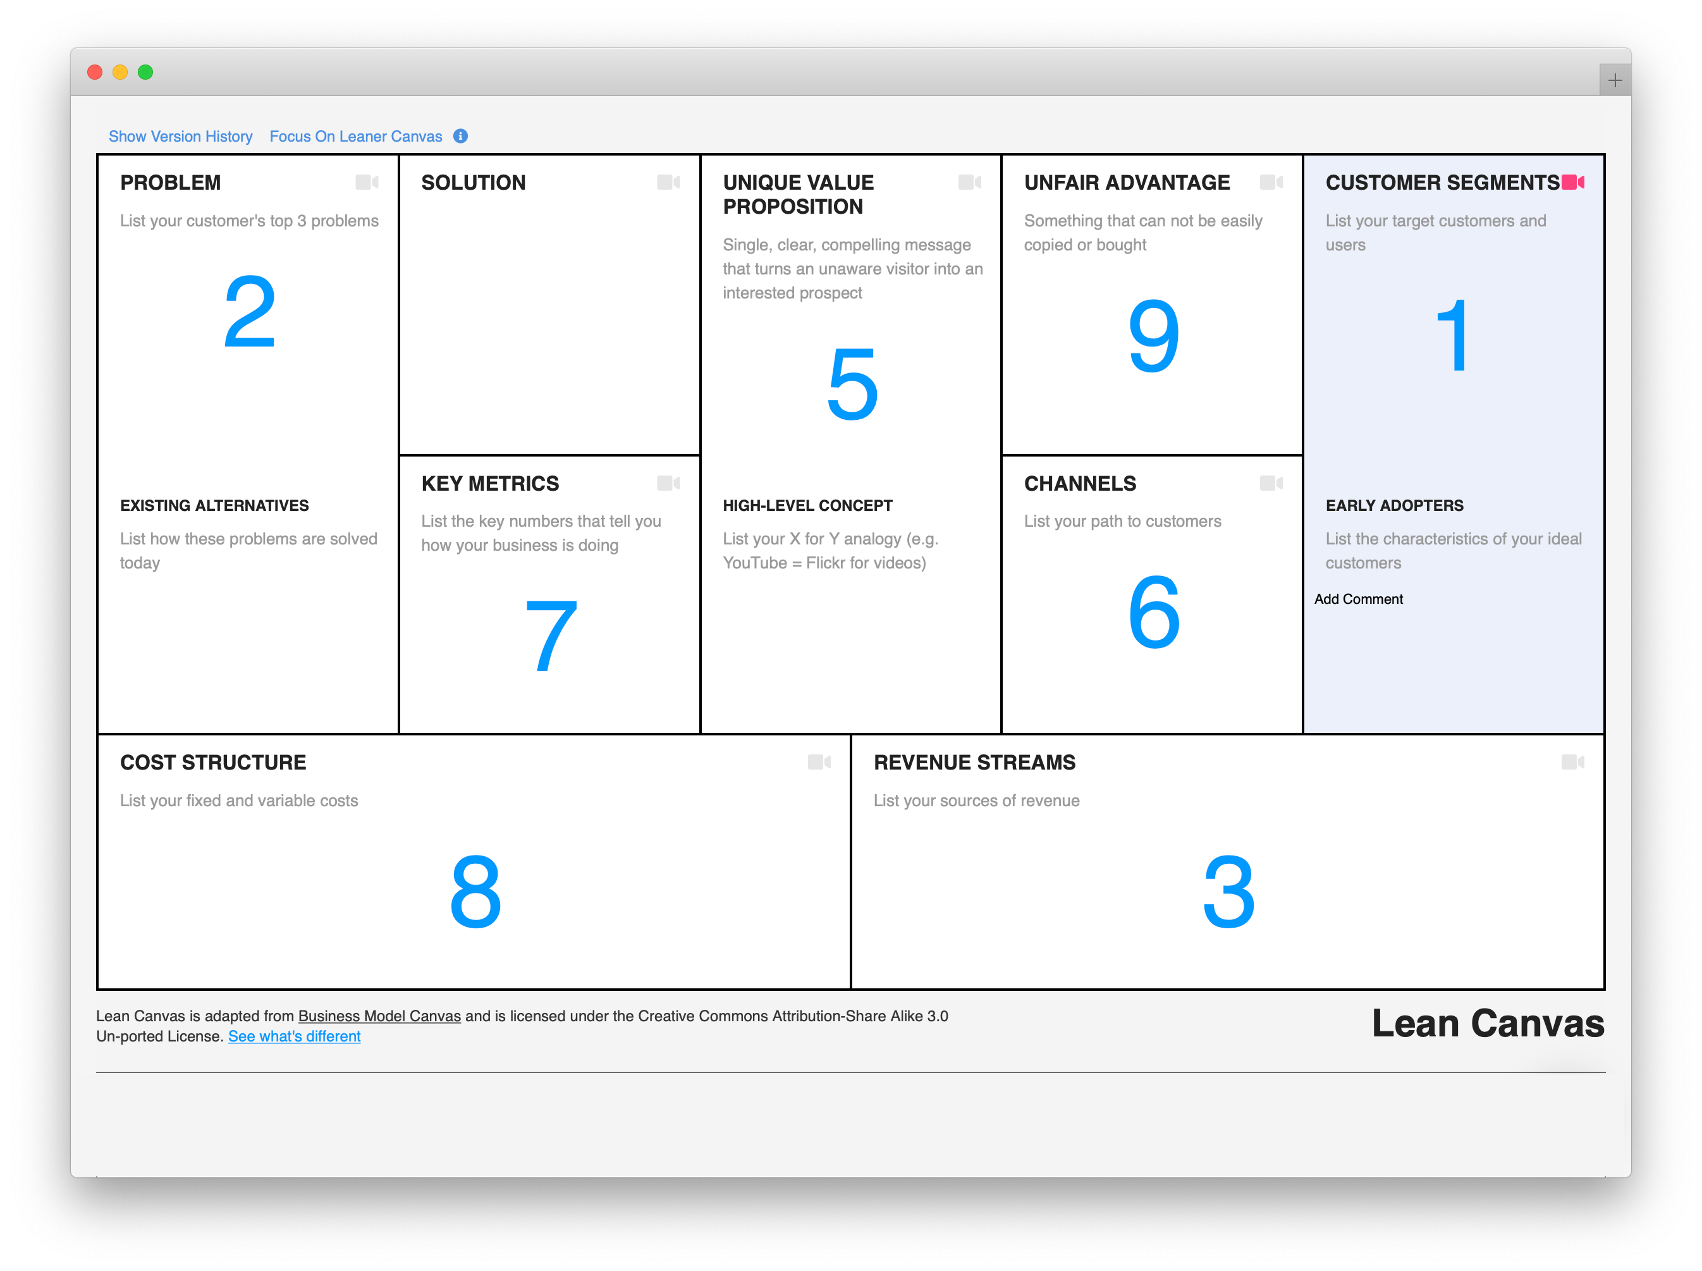

Slide 17
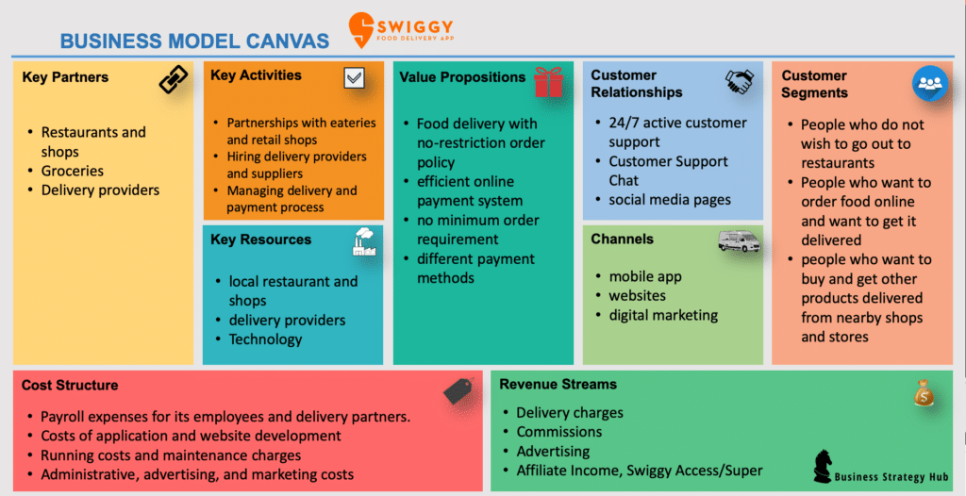
Business model

Slide 18
HOW TO APPROACH LEAN CANVAS?
First identify the problem or opportunity identification ,then define the customer segment which will help in identifying the new/innovative product or service.
This innovative Product result in offering right solution for targeted customer segment.
Problem
Customer Segment
Solution

Slide 19
LEAN CANVAS TEMPLATE:
1.Brainstorm on the target customers' problem and list down each problem
We have to put our self in customers' shoes and capture their 3 key frustrations that we intend to serve.
Find out the existing alternatives to our offering (per each problem ) that customers may utilize to meet their needs.
2.Analyze Target customer segments.
The customers are not necessarily the users of product (e.g. users of dog food are dogs, however, these are dog owners who buy stuff for the pets).
We need to find the potential early adopters of the product.

Slide 20
3.Formulate your unique value proposition.
UVP is precise statement that reflects the promise of value of product delivers. It explains how it solves your customer's problems (relevancy), outlines specific benefits (quantified value), and tells what makes your product better than the competitors' one (unique differentiation).
Get inspired by UVP's of admired brands and come up with a unique UVP that helps you differentiate meaningfully, targeting your early adopters, and keeping their key problem in mind.
Example: YouTube — "Flickr for video", Aliens (movie) — "Jaws in space".
4.Unfair advantage
An unfair advantage is something that cannot easily be copied or bought by the competition and is compelling enough - for target customers to choose the product over the existing alternatives.
It can come from a number of sources, be it in-depth knowledge of a specific domain (e.g. multiyear expertise in a given industry), intense focus on one domain (e.g. Google's focus on search engine), the community behind brand (think of Facebook or Apple ecosystem users), etc.

Slide 21
5. Envision your Solution
Shift to the Solution section reflecting your product vision, its possible details and features.
Ideally, do this in a team workshop, be open-minded and collect various ideas with some figures/evidence.
Smallest solution we build so that customers is ready to pay for it.

Slide 22
6. Think of promotion channels
All the possible channels we can utilize to promote offering: free ones (like social media, SEO, blogging, etc.) and the paid ones (Facebook ads, Google ads, LinkedIn ads, directories listings, trade fairs, etc).
How do you want to reach your customers?
Automate activities, where possible and efficient. Also, think of retention first, rather than of referral. Its crucial to have a product worth spreading first, and then attempt to go viral.

Slide 23
7. Revenue streams and cost structure
We have to note down intended revenue streams.To make things simple, start with a single and simple pricing plan first. It can be tested and got back to at later stages.
8.Write down your key metrics
Set up the clear metrics that can be easily measured regularly, in order to tell you how the business is doing.
Metrics reflecting new users acquisition (e.g. No of app downloads, or user registrations), users engagement (No of interactions with your brand in SM - likes/reposts, followers base growth, referrals), user retention figures (e.g. No of active product/service users monthly), your expenses (e.g. funds spent on travel, or ads costs), etc.

Slide 24
The Rapid shifts in the Business Model is what differentiates Start-ups from Established Company
-STEVE BLANKS

Slide 25
Types of business model
1) Manufacturing model
2) Distributor Model
3) E-tailer/Online Model
4) Aggregator/Influencer (commission) Model
5) Franchise model
6) Bricks and clicks Model
7) Subscription model
8) Freemium model
9) SAAS Model
10) Market Place

Slide 26
1.MANUFACTURING MODEL
It sells a finished product to Distributors and then to the final customers.
Ex: Samsung, Philips, Cross, Rotomatic.
2.DISTRIBUTORS MODEL
It buys finished products from manufactures and sells to the retailer who sells directly to the customer.
Ex: Car Dealership, Food Chains

Slide 27
3.E-tailer/Online Model:
It sells the products online without Brick and Mortar store.
Ex: Flipkart,Amazon,LINIO
4.Aggregators:
Brings multiple service providers under one brand and offers them to the customers. They earn money through commissioning.
Ex: OYO Rooms,UBER

Slide 28
5.Franchise:
They can be distributor or retailer. They uses the product or Business model of partnerships. It has to pay Royalty fees for Parent company of using the Brand.
Ex: The Body shop ,Mc Donald.
6.Bricks and Clicks:
Offline as well as Online shopping opportunities for customers
Ex: Clothing Business
7.Subscription:
Customers pay fixed amount as subscription fees at regular intervals. Business charge a subscription fee (monthly, annually, etc.) for customers to access a service. This type of business model can be adjusted and customized for each individual business.
Ex: Netflix,The Gift Box

Slide 29
There are some digital products used for photos, Software and Videos.
FREEMIUM: Most common Business model found on internet. Freemium, is "free" and "premium", is a pricing strategy by which a basic product or service is provided free of charge, but money (a premium) is charged for additional features, services, or virtual (online) or physical (offline) goods that expand the functionality of the free version of the software.
Ex: Zendesk,Trello

Slide 30
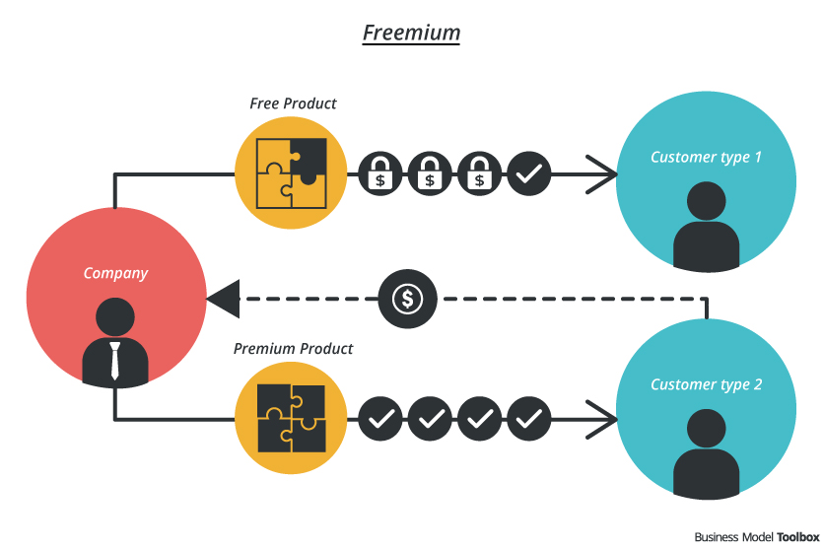
.

Slide 31
SAAS(Software as a service):It is a software licensing and delivery model in which software is licensed on a subscription basis and is centrally hosted. It is sometimes referred to as "on-demand software", and was formerly referred to as "software plus services" by Microsoft. SaaS applications are also known as on-demand software and Web-based/Web-hosted software.
SaaS is considered to be part of cloud computing.
Ex: Zendesk, MS office, Desault Ansys, Catia etc.

Slide 32
MARKET PLACE:
It is a platform where vendors and customers buy and sell products.
Vendors no need to pay money for marketing and customers pay the money for the trusted platform.
A pure ecommerce marketplace follows a zero inventory model. eBay, Naaptol, and Shop cluesare examples of e-commerce players that follow the marketplace model. The company acts as a meeting ground for buyers and sellers without storing goods. But they do offer shipping and payment assistance by tying up with selected logistics players and financial partners.
Ex: e-bay, Shutter stock

Slide 33
Pivoting and Refinement of business model

Slide 34
1.A pivot means fundamentally changing the direction of a business when you realize the current products or services aren't meeting the needs of the market. The main goal of a pivot is to help a company improve revenue or survive in the market, but the way you pivot your business can make all the difference.
2.Pivots are the essence of Entrepreneurs and Key to start up success. If you can’t pivot chances are quickly we will fail.
3.Create a new product or service or modify the existing one.
4.Pivoting answers the questions like Does the customer need the product and is the customer right segment
Ex: REDBUS is Bus book software for Bus operators to Online ticketing platform for customers.

Slide 35
Need for Pivoting
Don’t Builds a product that nobody wants Ex: Google glass
Was the solution is indeed solving the customer problem
Is it Problem-Solution fit and Product-Market fit.
Hitting the plateau with respect to the growth
Fall in number of returning customers
Changing needs of the Market.
Ex: Minglebox unable to compete with Giant Leader Face book so introduces Online Education portal.

Slide 36
A pivot is not a magic pill that can solve all your business woes. Companies should only consider pivoting when absolutely necessary. It should be the last resort when all other options have been exhausted.
It may be the right time to pivot your business if:
• You can't see much progress even after putting in a tremendous amount of money and resources.
• There is just too much competition.
• The company's progress has plateaued.
• Only one of your company’s features or services gets traction.
• Customers aren't responding to your products like you thought they would.
• Your perspective about the industry has changed

Slide 37
NPS (Net Promotion Score)
NPS is to test find your market –product fit.
How likely we recommend company X to a friend or Colleague.
These inputs are converted into Quantifiable score
If NPS>=0,GOOD
NPS<=0,NEGATIVE ,Need to be pivoted .
Pivoting is a strategy to help to show the right direction and achieve new heights.

Slide 38
Business Plan | Business Model
1.It is a road map of how you develop a product or service 2.Formal plan of reaching or achieving the Business goals. 3.It helps to develop a product/service | 1.It answers the question like how we can deliver value added products/services and monetize its value. 2. It clearly lays out the problem and find the solution. 3.How the business generates revenues and profits. Based on Business Model we can create Business plan.

Slide 39
Business Refinement
On How to Fine Tune The Business Model to Increase Revenue:
In order to think about how you can make your business model more innovative from an income generation perspective, consider these questions:
1. Are there people or businesses that could use my goods or services but don’t currently have access to them? Would it be beneficial for me to reach out to such
a group?
Example: One of the major business model innovations in the South African cell phone industry was “pay-as-you-go”. By changing the nature of the offering, South African cell phone companies were able to tap into much larger markets. MTN and Vodacom were global pioneers in the pay-as-you-go cell phone business model and it is one of the reasons that both companies have been so successful.

Slide 40
2. Are there people who are not buying what I offer because of the price point? If I shifted the price point up or down and adjusted my offering could I tap into a whole new market?
Example: Kulula.com radically expanded the market for airline travel in South Africa by dropping the price point for domestic airline tickets. Virgin Active innovatively expanded their offering by creating classic clubs with a premium offering and a higher price point to establish exclusivity for those willing to pay for it.
3. Is everything you are doing for customers providing them with value? Could you simplify or lessen your offering without impacting your customers’ perception of value?
Example: Outsurance discovered that not everyone valued the services of a broker when buying insurance. People were willing to do the work of a broker themselves if they were given the right information. Outsurance created the highly successful direct model for selling insurance.

Slide 41
4. Are there additional untapped revenue streams that you could exploit?
Example: Vida e Caffe don’t only sell great coffee, they also sell advertising space, creating lucrative additional revenue streams. They produce and sell advertising space in a quarterly magazine called Obrigado that is available in their stores. They also sell advertising space on their take away cup holders and little tags attached to their in-store mugs.
5. Are there ways that you could alter the timing of revenue collection to benefit the business? Most smaller businesses benefit by getting cash in earlier to speed
up cash flow.

Slide 42
REFINEMENT OF BUSINESS MODEL:
Refining Business Model means solving same problem in differently.
We refine the Business Model because of the following reasons
1.To grow your revenues
2.To come up with fresh ideas and to stay in the competition
3.To become more profitable
4. To address changing g tastes of customers
5.To bring in new technologies and trends
6.To comply to changes in taxes and custom duty
7.To address the large customer database.

Slide 43
By refining Business model we should see that cost structure decreases ,revenue stream increases and new distribution channels gets added.
Ex: Clothing companies like fabIndia,Mark Spencer has refined their business model b y adding new distribution channel online sales.Cost increased in terms of generating new website,payment gateways and advertising in digital marketing. Revenues are increased due to additional distribution channel.

Slide 44
It is important to note that refining Business model means Pivoting
Create a new product or services model means Pivoting.
Pivoting helps in getting customers and generating revenues.
Pivoting is essential when entrepreneur experiment fails.
Ex: 1.SLACK ,online game in 2008 was failed initially and it refined its Business model to a Professional Chat services.
2.LEGO, a toy manufacturing company refined its Business model from toy manufacturers, building block toy to a new Business model where in customer select various toy pieces from 1000 different blocks and assemble to form a new Building or facility then send the orders for his assembled structure.

Slide 45
Manufacturing Business Model Refinement BM E tailer, Online Booking
Because of this refinement ,Cost structure and revenue stream changes.
3.LENSKART: They have reinvented their Business model from E tailer , Online shopping to Brick –mortar Eye store because customers felt that for eye glasses they need to personally select the lenses,eye glasses ,computerized eye power checking and if necessary opthamaologist advise and suggestion.
They have added a new distribution channel of going through off line from online the cost has increased but revenues also increased because they catered to customer needs and opened branches at all important locations of the different cities.

Slide 46
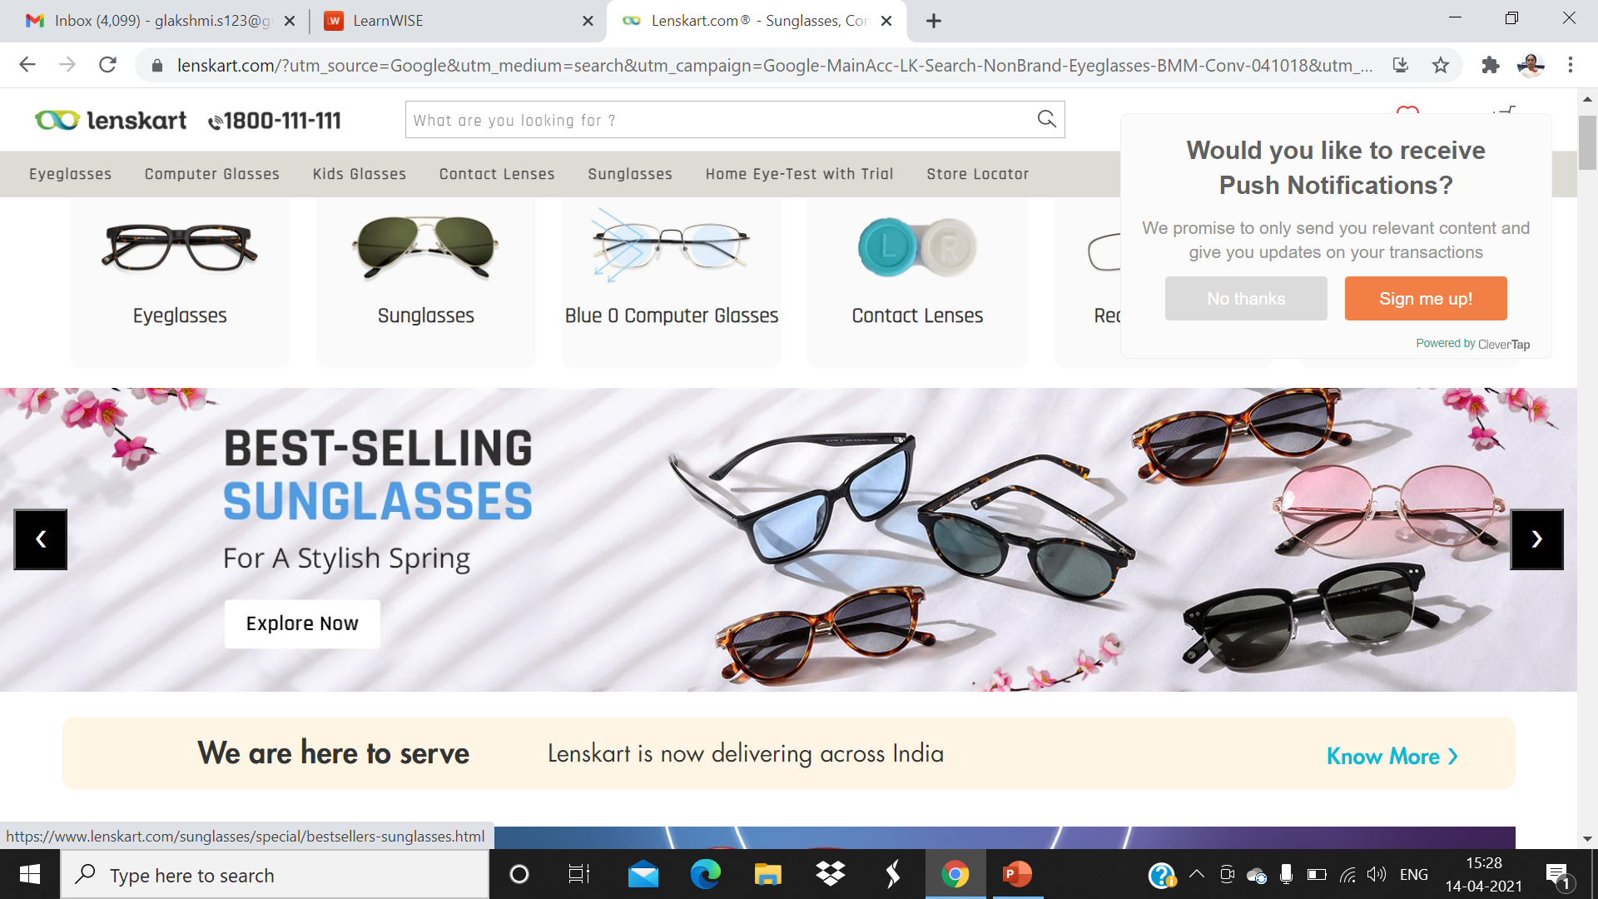

Slide 47
ANALYZING THE BUSINESS MODEL OF THE COMPETITORS
Entrepreneurs have constantly study the environment in which they operate.
Understand Competitors Business Model thoroughly
For Example: For prescription eye glasses and lens go out look for Brick and Mortar stores Business model, Onsite optometrists, types of customer segment they cater to,Are the prices too high or low, estimate costs ,hiring is expensive, setting up and investment costs are high, how they advertise, What are their marketing opportunities , Distribution channels, How many branches online Optician store have?.....
Sketch the Lean Canvas template of the Competitor based on the strengths like availability of Optometrist all the day, Fast turnaround time of making prescription Online glasses etc,
Work out on weaknesses like High Price, High Investment cost
Learn from the strengths and Benefit from weaknesses i.e Identify the strengths an weakenesses

Slide 48
Check out for Online e tailer for prescription eye glasses
Checkout any manufacturer has their own retail outlets
Build Your Own B.M
Research Competitor Business Model
Fill all the 9 blocks of Lean canvas template
Analyze the strenths and Weknesses of Competitor BM

Slide 49
By analyzing the competitor Business Model ,Borrow all the strengths from the competitor model, overcome the weakness of competitor model then frame Lean canvas template of our Business model with above modifications
Thus new model has reduced the set up cost ,lowered the price but implemented fast turnaround of time of competitor proves to be Best Business model.

Slide 50
ADDING NEW CUSTOMER SEGMENT
We add new customer segment to
To increase revenues and expand business
For Adding new customer segment mwe need identify
Who are my existing customers
Can I add some more customer segments
Am I selling for B2B or B2C
Can I add more segment in B2B or B2C or both

Slide 51
For Example:1. OLA an online on demand Car services provide car services to both B2C and B2B
In 2010 OLA was catering to only B2C booked cabs via app.
In 2016 OLA started corporate services B2B where employees avail cabs through prepaid account avoiding unneccary reimbursement.
OLA Started CORPORATE, LUX, SHARE type of Care services.
OLA Corporate for Corporate em[ployees,OLA LUX for customer availing Luxurious car of Audi,Benz etc, OLA share where customers share drive with other passengers at economical price.
2.Youtube in 2017 started You tube kids that cater only to kids segment with parents control of what they have to do with various features present in it.

Slide 52
3.If Mens shaving accessories Manufacturing company wants to cater to the Women They have to create a separate Business model as below. First the Solution, the product should have different blades, nice handle etc.
New distribution channel ,it may focus on beauty stores and E-commerce and Relook at the cost structure.

Slide 53
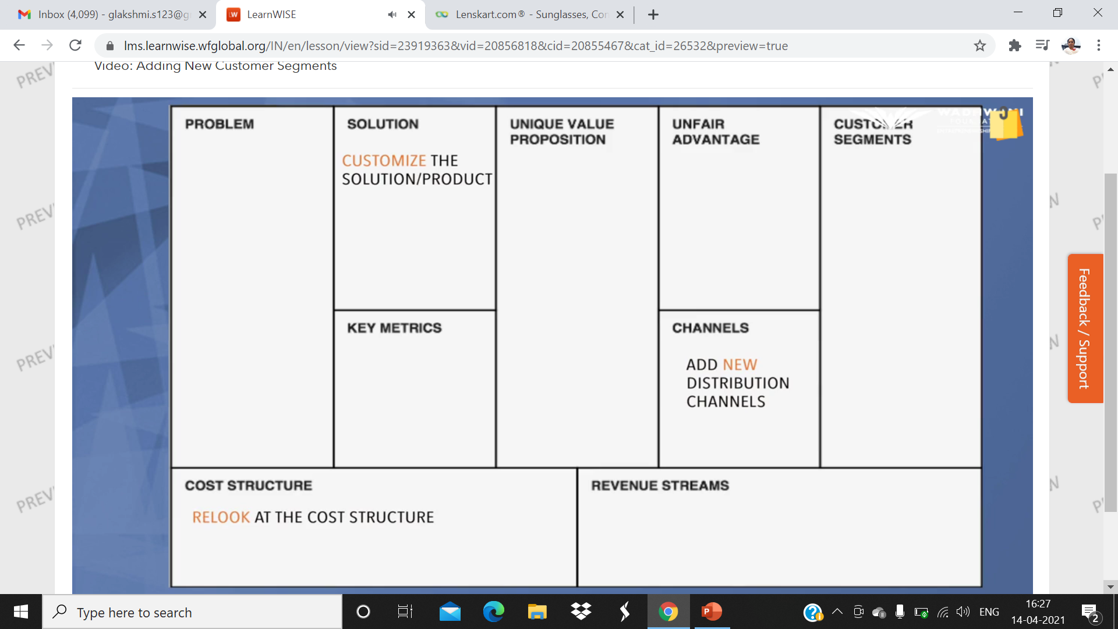

Slide 54
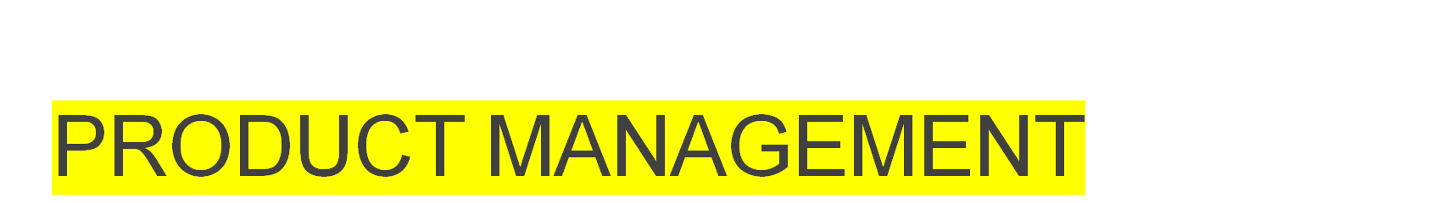
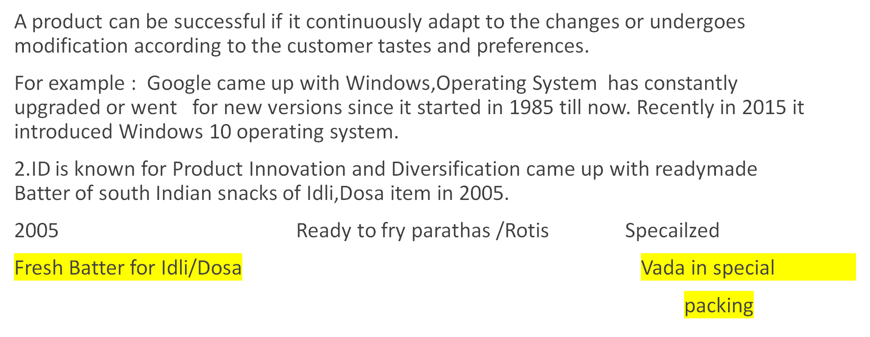

Slide 55


Slide 56
Product Management bridges the gap between Business and the Customer.
What is effective Product Management
Prersenting changing needs and ttrends of the customer
Bridging gap between Product design and Cuastomer usage
Collaborating Engineers,Designers and the Customers
Helping the customers come up with Blockbuster products
Product management was very effective in OLA
1.OLA Cab aggregator
2.OLA Share
3.OLA Auto
OLA Ouytstation
OLA Prime,OLA Prime Plan,OLA Credit

Slide 57
Product Manager
What is a Product Manager?
The Product Manager is responsible for delivering a differentiated product to market that addresses a market need and represents a viable business opportunity. A key component of the Product Manager role is ensuring that the product supports the company’s overall strategy and goals.

Slide 58
Product manager scope of his Job
In most cases, the description of Product Manager covers an incredibly wide range of skills. However, most Product Manager roles have several key components:
Domain expertise: Very often, your knowledge of your market and product area is why your company hired you. The fact that you know the customers and the business is the main reason you’re now a Product Manager.
Business expertise: People say that the Product Manager is the CEO of the product. Though that is not typically 100% true, making sure the company is generating a profit is usually involved. You need to have a suite of business skills to keep your product profitable.
Leadership skills: Many people within your company are looking to you for guidance. If you don’t have leadership skills under your belt, you need to develop them quickly.
Operational ability: Product Managers need to dive deep into the many nitty-gritty details needed to manage a product: for example, creating part numbers or updating a spreadsheet. Sometimes you can get someone else to do these tasks, but many times you are responsible for them.

Slide 59
What Does a Product Manager Do?
The Product Manager:
Defines the product vision, strategy, and roadmap.
Gathers, manages, and prioritizes market/customer requirements.
Acts as the customer advocate articulating the user’s and/or buyer’s needs.
Works closely with engineering, sales, marketing, and support to ensure business case and customer satisfaction goals are met.

Slide 60
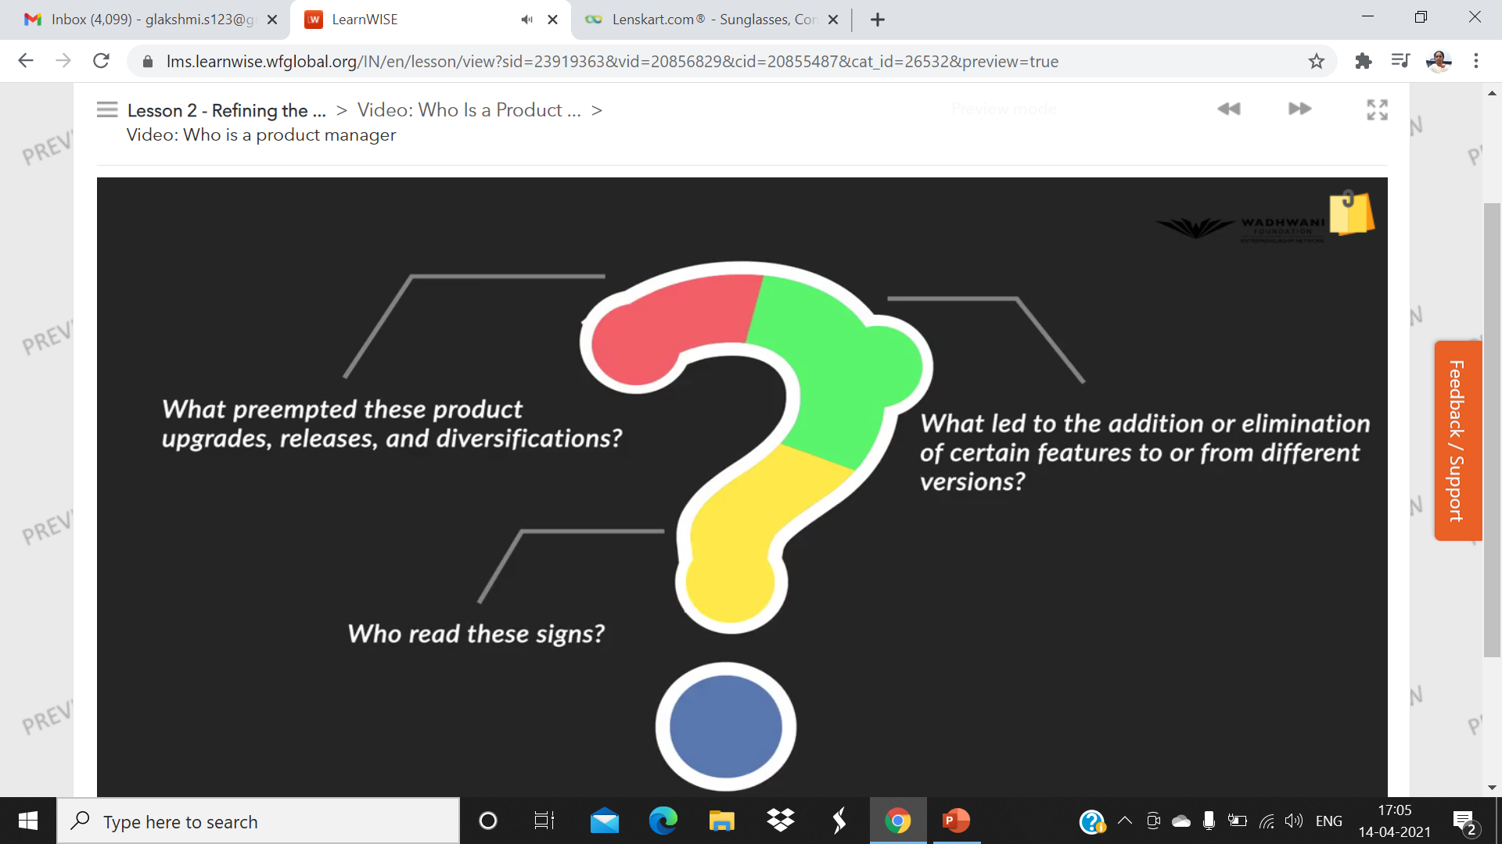

Slide 61
Product Manger
Designs,Create,Market,sell and improve the existing product.He /She who involved in idea generation,design the product , manufacturing and testing.
Interior Team PRODUCT MANAGER User Interface
1.Engineering 1.User Experience
2.Design 2.Data Analysis
3. Packaging 3. Customer Behaviour
4.Track Customer
Feedback

Slide 62
What happened if Product Manager fails to foresee
Undoubtedly face the losses and lost customer trust and loyalty.The following are the examples
1.P&G product Gillette Vector Razor product was outcome of spent 3000 hrs and MIT graduates hard work of getting clogged after single use and declogged under running water. This product meant for Indian mens. But Indian men use cup of water instead of running water for cleaning their razors ,so the product was very big failure.
2.Snapchat a multi media Messaging App used by yopunng people around the world was quite good till Nov,2017.
When it wanted to achieve the goal of simple personalized user experience for navigation for new users, 1.2 million users signed up petition of roll back of UI changes and there was sharp decline in stock prices.

Slide 63
So Product Manger play an important role
Not only coming up with products of customer wants but also what delights them
Constantly they need to Observation( what customer does with the product),Empathy and working on the Customer feedback.
Make the Product more aligned to the Customer

Slide 64
Thank You

